Slide 1
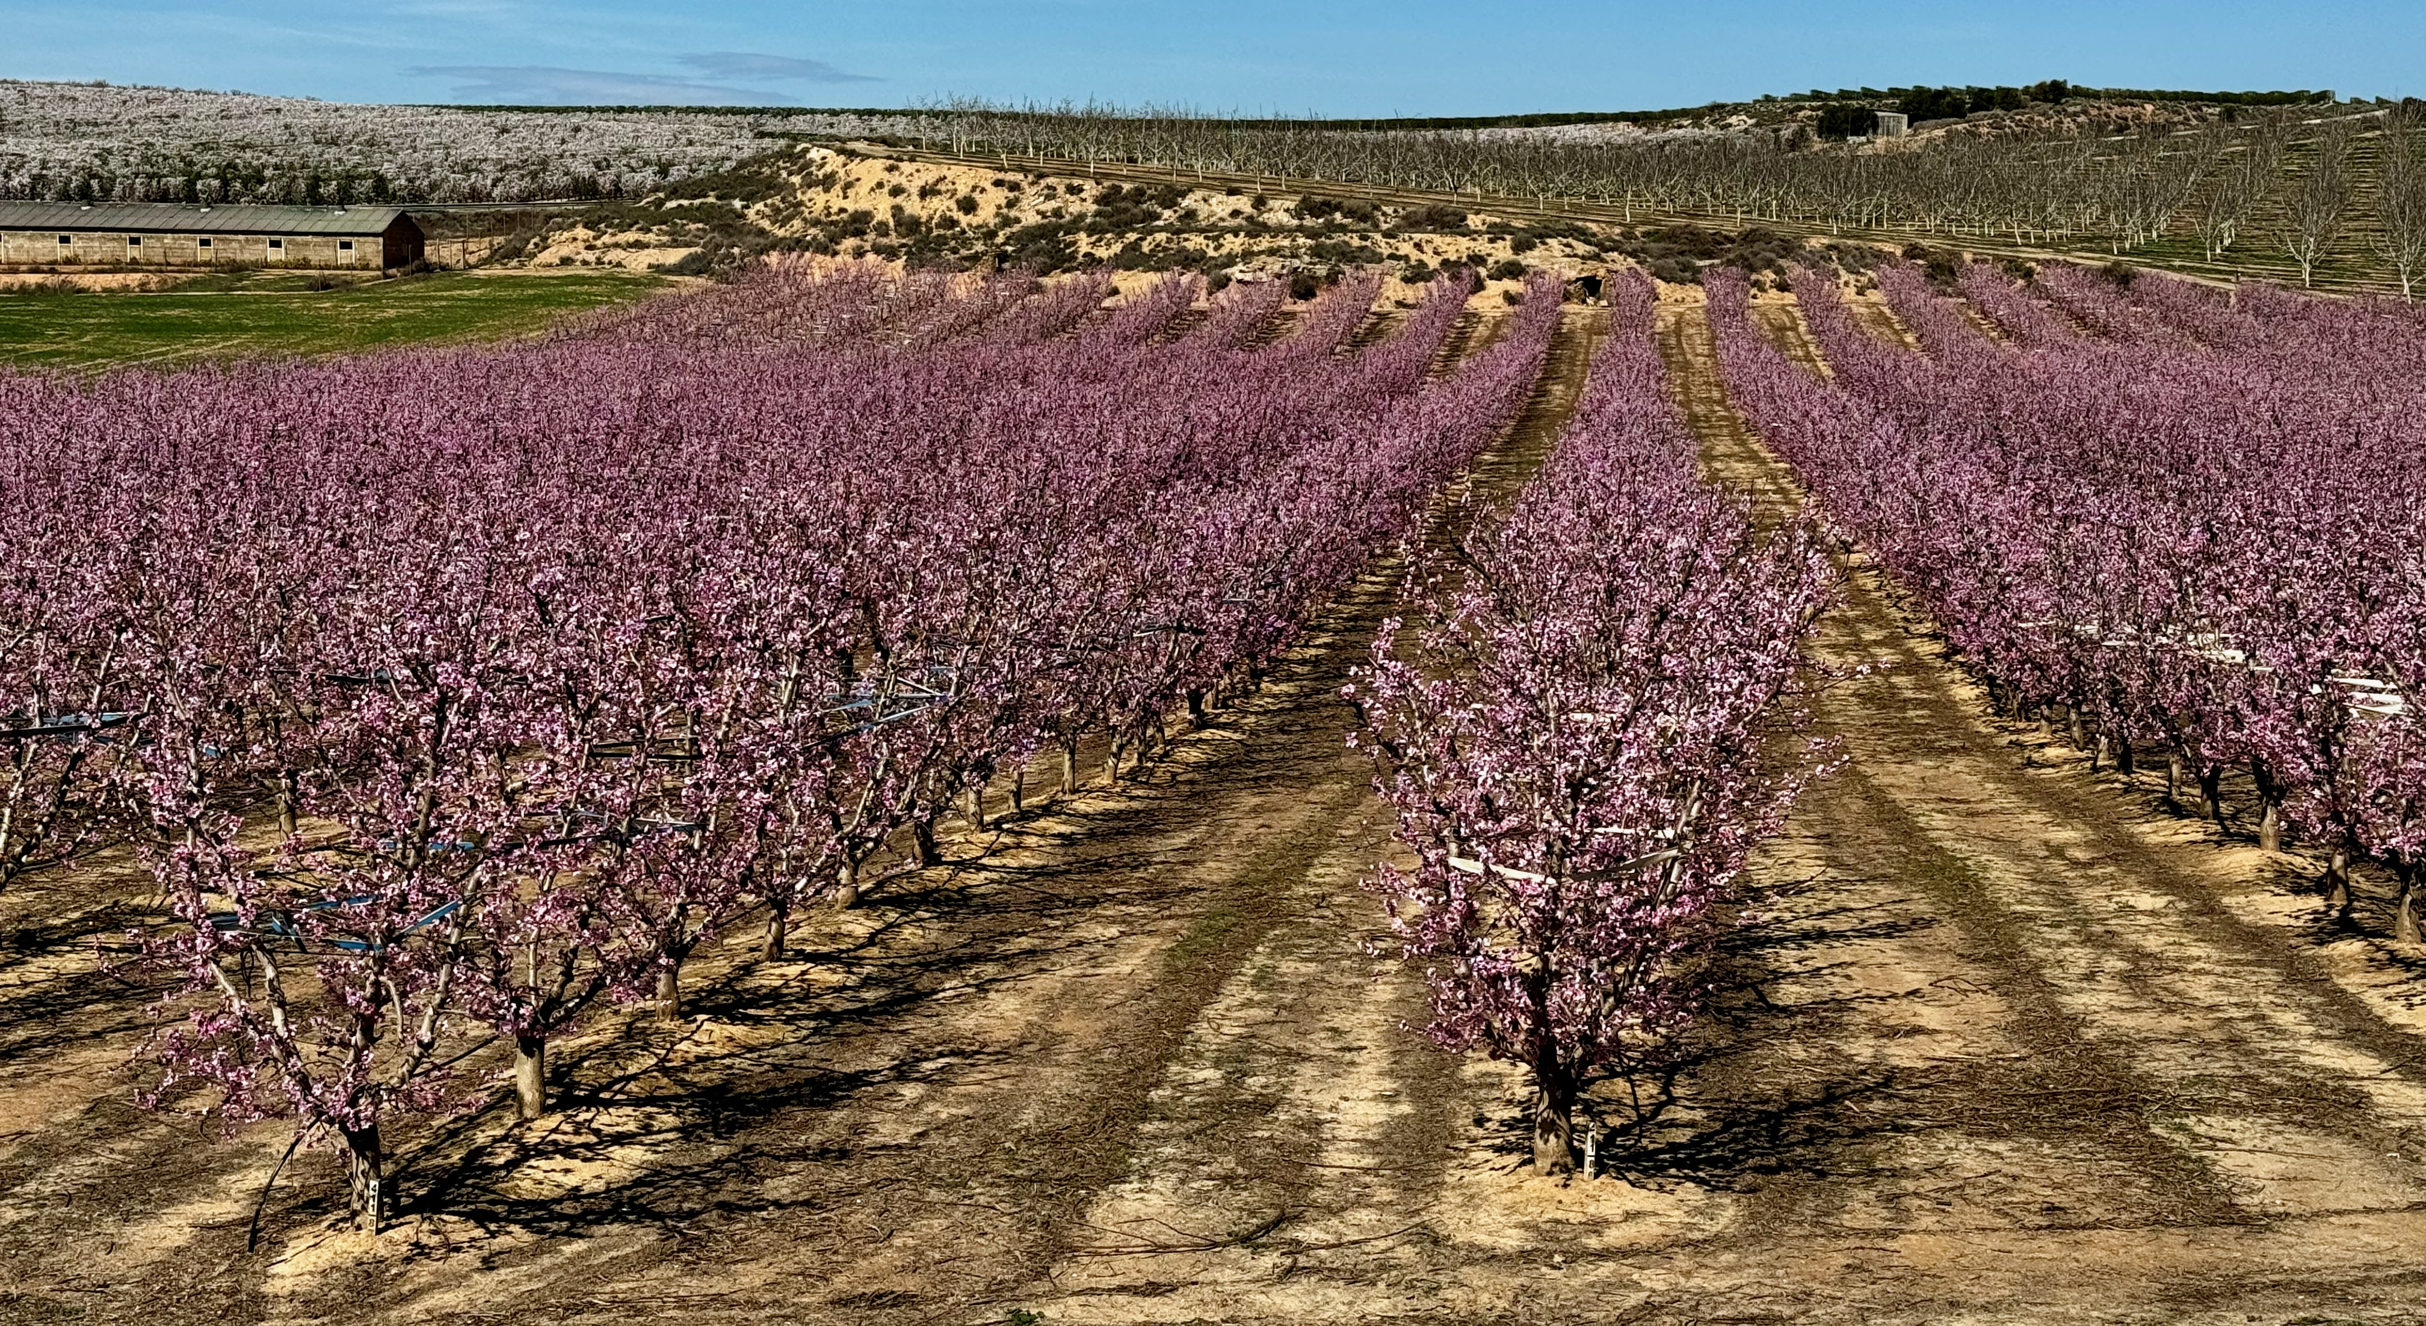




Nexus Eau-Énergie-Alimentation-Écosystemes: Approche et Solutions Innovantes intelligentes dans la filière agrumes
23 et 24 juilet 2025, RABAT
SURENEXUS Project: Challenges, Barriers & Facilitators for WEFE NEXUS

Slide 2



WEFE NEXUS CHALLENGES
BARRIERS
CHALLENGES
FACILITATORS
Notes:
Goodafternoon and thenks for the invitation
Today we will introduce the planetary boundaries, but before we would like to present us and our research group.

Slide 3
1 CHALLENGES
Area | Rank | Main Challenge | Description
Climate and Environment | 1 | Climate change and extreme phenomena | Adaptation and Mitigation. Capacity development for farmers & Producers. Drought intenesity and frequency, Late frosts, heatwaves, and new pests affect yields and quality.
Water Resources | 1 | Water scarcity, quality and management | Better genetic improvement and adaptation, Flow reductions, need for efficient irrigation, and limited infrastructure. Pollution, including salinity. Cost of water treatment and management (Surface and groundwater) Valorization of water. Ground recharge. Wastewater uses in agricultura. Resiulient agricultura including renewable energy adoption.
Economic and Market | 2 | Economic and market pressure | Low farmgate prices and rising production costs (energy, inputs, transport). WEFE Nexus implementation. Integration value chains,
Social and Labor |  | Generational renewal and labor shortages | Social Impacts and burden. Difficulty finding young successors and covering seasonal labor demand.
Technological and Sustainable | 3 | Low innovation and sustainability challenges | Low capacity building, digitization, difficulties implementing agroecological practices. Recycling plastic and Human and Animal Health. Innovation of water treatment. Advanced innovation in water treatment.
Commercialization |  | Market dependence and lack of added value | Dependence on few markets and missed opportunities in local/organic markets.
Regulatory and Administrative |  | Regulatory complexity and bureaucracy | Constant changes, difficulties accessing subsidies, and administrative overload.
Notes:
Goodafternoon and thenks for the invitation
Today we will introduce the planetary boundaries, but before we would like to present us and our research group.

Slide 4
2 BARRIERS
Type of Barrier | Description
Institutional and Governance | Institutional fragmentation: lack of coordination between departments (water, energy, agriculture, environment). Absence of integrated WEFE governance: lack of legal frameworks or strategies to address the Nexus holistically. Disconnected sectoral decisions: water, energy, or food policies developed in isolation.
Economic and Financial | High initial costs: investments in water efficiency systems, renewable energy, or agroecological practices. Limited access to green financing: small producers and cooperatives struggle to access sustainable financial instruments. Lack of economic incentives aligned with the Nexus: subsidies often don’t promote intersectoral practices. SDG tracking and development.
Technical and Data sharing and use | Lack of integrated data across sectors (water, energy, production, ecosystems). Gap between science and management: scientific results are hard to apply or translate into practical actions. Low adoption of Nexus technologies: difficulties implementing digital technologies, sensors, decision support systems, etc. Development of advisory and consultany across sectors. Curricula development in education system to integrate circularity and WEFE Nexus Pillars
Social and Cultural | Lack of awareness of the Nexus concept among producers, technicians, and policymakers. Resistance to change by actors accustomed to traditional approaches. Lack of training and capacity-building in integrated and sustainable approaches.
Environmental and Territorial | Increasing climate vulnerability (droughts, frosts, heatwaves) puts pressure on all sectors. Territorial inequalities in infrastructure, service access, and institutional support—especially in rural areas.
Regulatory and Legal | Rigid sectoral regulations hinder intersectoral action (e.g., water requirements ignoring energy/ecological uses). Legal uncertainty for innovation, especially in areas like water reuse or bioenergy. Lack of recognition of ecosystem services in legal frameworks.
Notes:
Goodafternoon and thenks for the invitation
Today we will introduce the planetary boundaries, but before we would like to present us and our research group.

Slide 5
3 FACILITATORS
Type of Enabler | Description
Institutional and Governance | Creation of intersectoral coordination spaces (Nexus platforms, joint technical committees). Integrated public policies addressing water, energy, food, and ecosystems transversally. Territorial plans with a Nexus approach included in regional development strategies.
Economic and Financial | Green fiscal incentives or subsidies for multisectoral impact projects. Specific Nexus financing funds (at EU, national, or regional level). Mixed financing instruments (public-private) for sustainable projects. Valuing ecosystem services within financing models.
Technical and Data | Integrated data platforms accessible to different sectors and actors. Digital decision support systems (DSS) integrating water, energy, food, and ecosystem variables. Emerging technologies applied to the Nexus (AI, digital twins, IoT sensors, etc.). Shared Nexus indicators for joint monitoring and evaluation.
Social and Cultural | Specific training on the WEFE Nexus for technicians, farmers, authorities, and students. Participation and co-creation programs with local actors. Narrative shift: from sectoral to systems thinking. Demonstration initiatives and local success stories that inspire trust and replication.
Environmental and Territorial | Shared green and blue infrastructures (terraces, natural reservoirs, biofilters). Community-based natural resource management using collaborative models. Participatory territorial diagnostics to identify priorities and vulnerabilities through a Nexus lens.
Regulatory and Legal | Regulatory review and harmonization to enable intersectoral action (e.g., water reuse, agrivoltaics). Creation of flexible and adaptive legal frameworks that allow innovation and climate scenario adaptation. Inclusion of the Nexus in environmental and territorial legislation (hydrological plans, CAP, land planning).
Notes:
Goodafternoon and thenks for the invitation
Today we will introduce the planetary boundaries, but before we would like to present us and our research group.

