Slide 1



Ensure fair NEXUS transition for climate change adaptation and sustainable development implementation based on coupled nature-based systems and bioeconomy

Slide 2





WP2 – Stakeholder Platform
WP2 Stakeholder Platform – SHP Workshops
SHP
DATA BASE
SHP
GUIDELINES
GOOGLE FORM
SHP MEMBERSHIP
LETTER OF ADHESION
SureNexus_SHP_Guidelines
Link to Google Form

Slide 3
WP2 – Stakeholder Platform
WP2 Stakeholder Platform – SHP Workshops
As a key stakeholder in implementing the WEFE Nexus approach in your country and the Mediterranean region, your organization is invited to join the SHP. Membership is voluntary and includes a range of actions that your organization can define in advance.
This document outlines the roles, contributions, responsibilities, and benefits of stakeholders, as well as mechanisms for transferring knowledge and lessons learned during the project.
At the end of this document, you will find a voluntary membership application form. If interested, you can specify your organization’s commitments as a member of the SHP and provide key information about your organization.
SHP GUIDELINES
SureNexus_SHP_Guidelines

Slide 4
WP2 – Stakeholder Platform
WP2 Stakeholder Platform – SHP Workshops
To this end, network members are expected to:
Foster trust and active collaboration within the network.
Ensure consistent and open information exchange across the network.
Promote co-learning processes among the various local networks.
Public Organizations | Local Government
 | National-Subnational Government
Research Organizations | Reaserch centres & Universities
Private Organizations | Agri-food Companies
 | Local Producers
 | Water/Energy Utilities
Non-governmental Organizations | Customer Associations /NGOs

Slide 5

WP2 – Stakeholder Platform
Fostering networking and clustering
Advantages to be a member of SHP
Main SureNexus Activity | Specific Acivity
Continuous Training and Capacity Building I : General Courses | WEFE Nexus (Approach, Governance, Metrics)
 | NbS & Ecosystems health and services
 | Circular “carbon” Bioeconomy
Continuous Training and Capacity Building II : Specialized Courses | AI Modelling & Scenario analysis for WEFE Nexus
 | NBS & Ancestral Hydrotechnologies
 | Climate change adaptation & WEFE nexus
 | Nexus Enabling Factors, Nexus Drivers of Change & Sustainability Indicators
On-demand Consultancy | Bioeconomy Practices
 | Digital agriculture & Agrivoltaics
 | Technology selection for water/wastewater treatment using NBS
 | Concerns in the Agricultural Sector (pollution, irrigation, …)
 | Resource efficiency (energy and water)
 | Climate change scenarios
Access to Technical Summaries and Newletters & Reports | Technical Summaries (reports available for main documents in 6 languages: EN, SP, IT, FR, GR, AR).
 | Newsletters,
 | Policy briefs
 | Award recognizing best initiatives on WEFE Nexus
Networking Opportunities & Join Actions | Stay Updated: Conferences / Workshops/ webinars/ Online Forums & Discussion Groups
 | Exchange of knowledge and experience about WEFE-NEXUS approach
 | Access to solutions from similar sector/Climate context

Slide 6
WP2 – Stakeholder Platform
Fostering networking and clustering
Advantages to be a member of SHP
SureNexus Outcomes | Outcome Access for SHP members
Continuous Training and Capacity Building (General & Specialized courses) | Access to workshops / Conferences (discounted fees)
 | Access to Formation Materials
 | Recognized certification
On-demand Consultancy | 4 free consultations per organization (Annually)
 | 1 Climate Change scenario per location (Annually)
Access to Technical Summaries and Newletters & Reports | Access to Technical Summaries (reports available for main documents in 6 languages: EN, SP, IT, FR, GR, AR).
 | 1 report from each DS (4 sectorial reports)
 | 1 technical report on Plastics in Agriculture (CTPC)
 | 1 technical report on NbS for Agriculture
 | 1 technical report on Bioeconomy solutions for Agriculture
 | Free access for registered members to: Newsletters, Reports, Summaries, Guidelines, White Reports, …
Networking Opportunities & Join Actions | Access for Partners to the “Solutions to Similar Problems” Database (SiProS)
 | Direct easy access to WEFE Nexus Community of Practices
 | Access to and Use of the SHP Members Database

Slide 7

WP2 – Stakeholder Platform
The platform was designed and developed
https://surenexus.eu/shp-map/
Primary objective of the platform is to promote collaboration among stakeholders by offering a centralized hub for sharing information and resources
SHP will facilitate formation of local chapters (geographical approach) and practice groups (thematic approach).

Slide 8



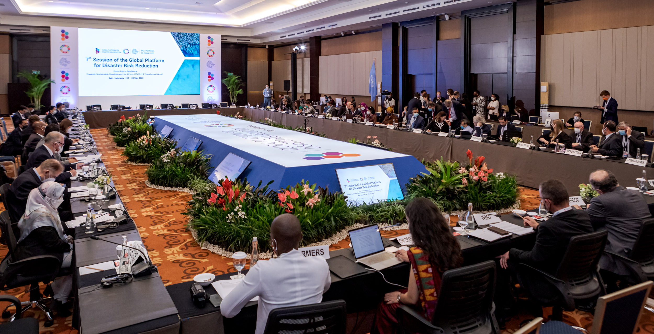
WP2 – Stakeholder Platform
WP2 Stakeholder Platform – Roadmap for SHP Workshops
INVITE
SH
MAY-JULY
1
SURENEXUS PRESENTATION
2
UPDATE SHP
DATA BASE
3
DECIDE DATA FOR EVENTS
4
PREPARE NEWSLETTER
5
NATIONAL EVENTS
(Hybrid)
UPC / NTUA
ALL PARTNERS
NTUA (English)
GREECE
MOROCCO
SPAIN
ITALY
TUNISIA
ISRAEL
EGYPT
UPC (Spanish)
UNIVPM (Italy)
INRA (Arabic/French)
APRIL

Slide 9

Ensure fair NEXUS transition for climate change adaptation and sustainable development implementation based on coupled nature-based systems and bioeconomy

